Slide 1
Classes & Objects
By Manoj.Karnatapu
NB HealthCare Technologies.

Slide 2
Class
In object-oriented programming, a class is a blueprint for creating objects (a particular data structure), providing initial values for state (member variables or attributes), and implementations of behavior (member functions or methods).
The user-defined objects are created using the class keyword.
The class is a blueprint that defines a nature of a future object. An instance is a specific object created from a particular class.
Classes are used to create and manage new objects and support inheritance—a key ingredient in object-oriented programming and a mechanism of reusing code

Slide 3
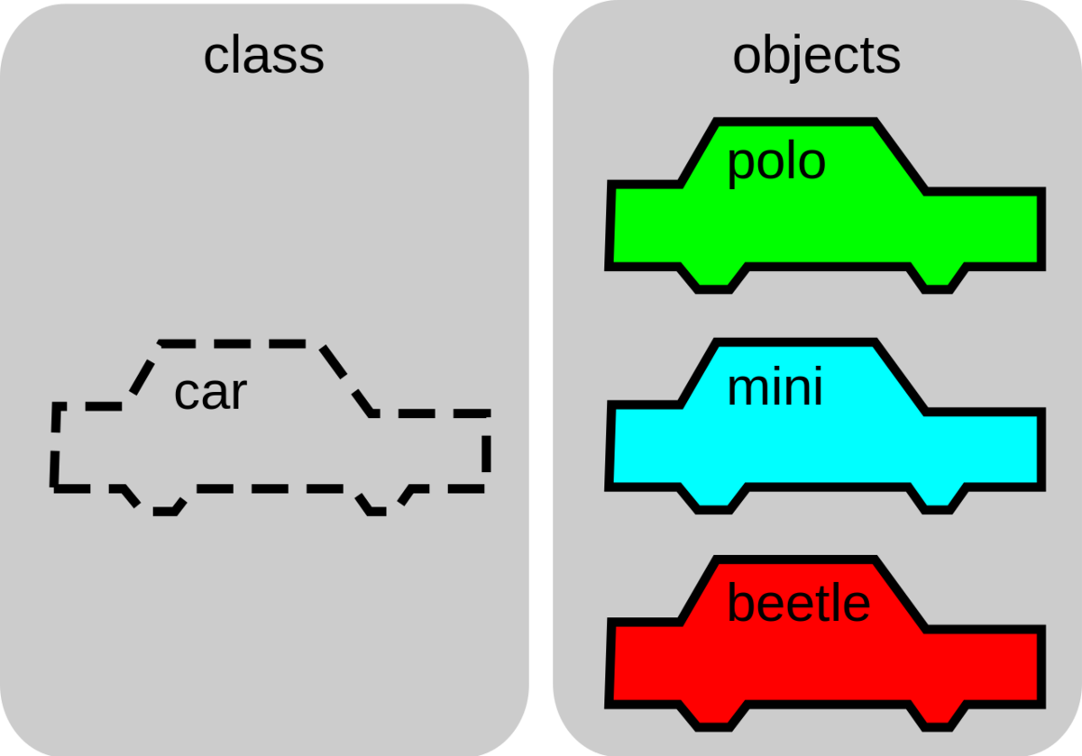
The image above shows how a Car object can be the template for many other Car instances.
In the image, there are three instances: polo, mini, and beetle. Here, we will make a new class called Car, that will structure a Car object to contain information about the car’s model, the color, how many passengers it can hold, its speed, etc.
A class can define types of operations, or methods, that can be performed on a Car object. For example, the Car class might specify an accelerate method, which would update the speed attribute of the car object.

Slide 4
A class is a way of organizing information about a type of data so a programmer can reuse elements when making multiple instances of that data type—
for example, if a programmer wanted to make three instances of Car, maybe a BMW, a Ferrari, and a Ford instance.
The Car class would allow the programmer to store similar information that is unique to each car (they are different models, and maybe different colors, etc.) and associate the appropriate information with each car.

Slide 5
Objects
In object-oriented programming (OOP), objects are the things you think about first in designing a program and they are also the units of code that are eventually derived from the process. ...
Each object is an instance of a particular class or subclass with the class's own methods or procedures and data variables.
An object is nothing but a self-contained component which consists of methods and properties to make a particular type of data useful. Object determines the behavior of the class. When you send a message to an object, you are asking the object to invoke or execute one of its methods.
From a programming point of view, an object can be a data structure, a variable or a function. It has a memory location allocated. The object is designed as class hierarchies.

Slide 6
Thank You

